Slide 1
MATLAB for Scientists Lecture 1
Dr. Allison J. Lopatkin
1014 Altschul Hall
alopatkin@barnard.edu

Slide 2
Getting into MATLAB
Operators, variables and assignment statements

Slide 3
The MATLAB environment
Window | Purpose
Command window | Main window; enters variables; runs program
Editor window | Creates and debugs script and function files
Command history window | Logs commands entered in the Command window
Workspace window | Provides information about the variables that are in use
Current folder window | Shows the files in the current directory
***See MATLAB Handbook

Slide 4
The MATLAB environment
Command line

Slide 5
Basic numeric operators
Pre-defined values
+ | Addition
- | Subtraction
/ | Division
* | Multiplication
^ | Exponentiation
pi | 3.14159…
i | sqrt(-1)
inf | Infinity
NaN | Not a number
*MATLAB follows order of precedence:
Parentheses, exponent, multiplication/division, addition/subtraction

Slide 6
Using the MATLAB command line for numeric operations
Adding/subtracting
Dividing/multiplying
Order of operations
pi

Slide 7
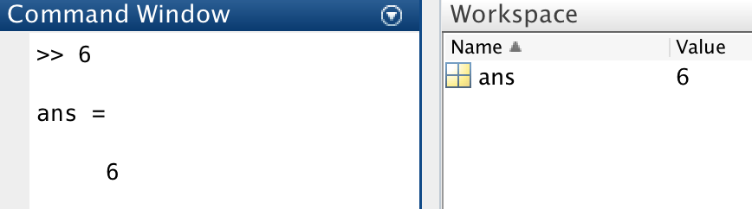
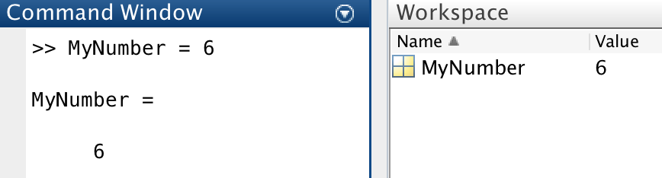
Variables and assignment statements
A variable is used to store a value during a MATLAB session
Assignment statements are used to create variables.
VariableName = a numerical value or computable expression
Unassigned variables are named ‘ans’ by default
Assigned variable name:

Slide 8
Rules for naming variables
The variable name being assigned is always on the left of an equal sign
INVALID: 6 = MyNumber
MATLAB is case-sensitive (and space in-sensitive)
MyNumber =/= MYNUMBER
The name must begin with a letter. After that, the name can contain letters, digits, and the underscore character (e.g., value_1), but it cannot have a space
Variable names should be mnemonic – describe the thing that you’re storing!
Do not use MATLAB functions as variable names, since this will overwrite it
size, length, pi, etc..
Reassigning variable names overwrites the previous value (why?)

Slide 9
Supported variable classes in MATLAB
char | Character array (defined by apostrophes, ‘ ’)
string | String array (defined by quotations, “ ”)
table | Table array
double | Double-precision floating point (Regular #, 64 bits, 2^64 numbers)
logical | Boolean true or false
uint8, uint16, uint32, uint64 | Unsigned integer
cell | Holds other datatypes of various sizes
struct | Structure

Slide 10
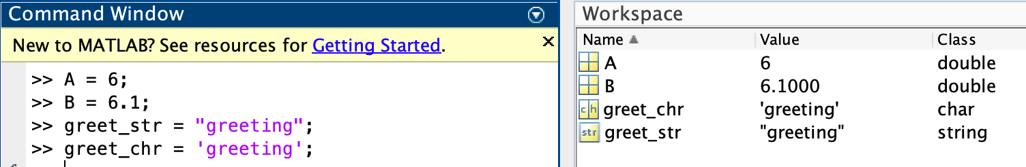
Variables and assignment statements for numerics and text
By default, numbers are assigned the variable class <double>
In contrast, string arrays and character arrays provide storage for text
Variables of the class <string> are defined using quotation marks
Variables of the class <char> are defined using apostrophe’s
Certain functions only perform operations on variables of the same class!

Slide 11
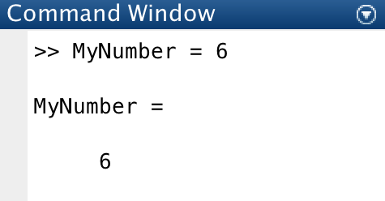
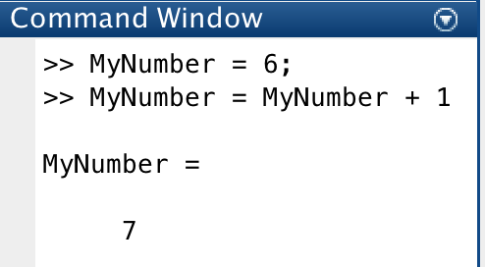
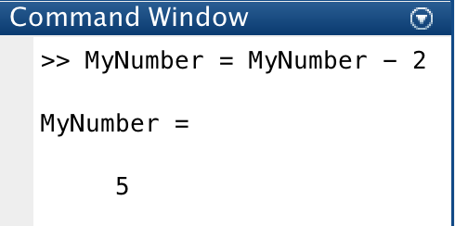
Working with variables
Setting initial value is called initializing the variable
Adding to a variable is called incrementing
How can we subtract? Called decrementing

Slide 12
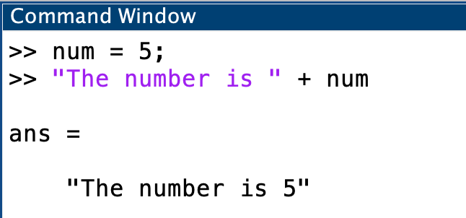
Displaying variables
Combining strings and numbers using < + >
Won’t always work with characters so stick with “ ”

Slide 13
Variable names and classes
Setting variable names to numeric values
Assigning strings as variables
Join strings and numbers
Incrementing with variables

Slide 14
Math functions
sqrt(x) | Square root
sum(x) | Adding numbers in a matrix
exp(x) | Exponent (e^{x})
abs(x) | Absolute value
log(x) | Log base e (natural log)
log10(x) | Log base 10
factorial(x) | Factorial function x!
sin(x) (and other trig) | Trigonometric operations
round(x) | Rounds to nearest integer
floor(x) (alt: ceil(x)) | Floor or ceiling rounding
help elfun
to view helpful information on these functions

Slide 15
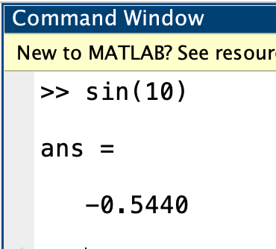
Built-in functions
Note the open/close parentheses on the previous slide
This denotes *calling* a function:
E.g., the sin function is called with the open/close parentheses and an input

Slide 16
Mathematical functions
Absolute value
Square root
Rounding
Exponent

Slide 17
Helpful functions general to MATLAB
% | comment
clear | Clear variable
clc | Clear screen
doc | Provides documentation in separate window
help | Provides command-line documentation
disp | Display the output on the command line
; | Suppress output
… | Wrap text

Slide 18
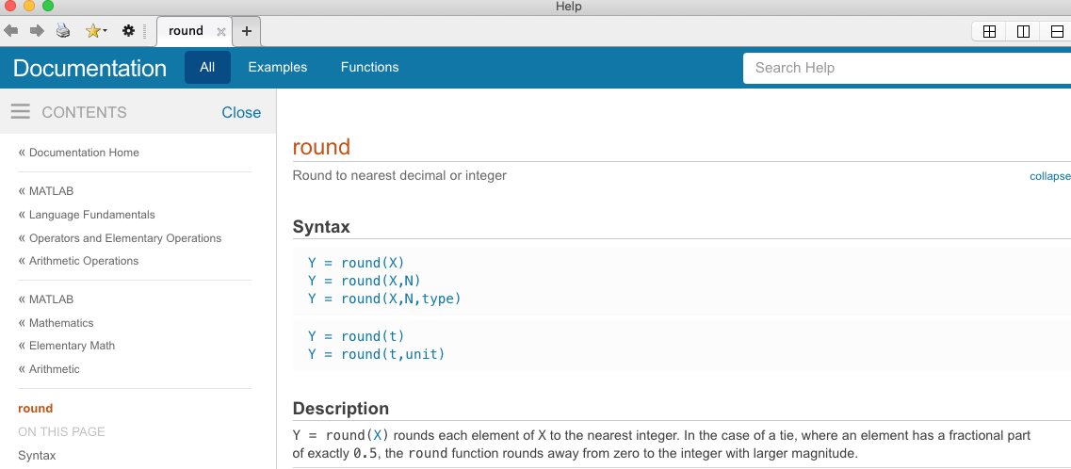
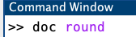
MATLAB doc and help are your biggest resources
Syntax: doc, space, function name, eg:
help has identical syntax
Question: Is round a function? How do you know? What about the variable classes on slide 9?

Slide 19
Variable names and classes
Define variables and suppress the output
Clear your workspace
Use doc to investigate disp. Is it a function? What about string?
What do we do when we get an error??!

Slide 20
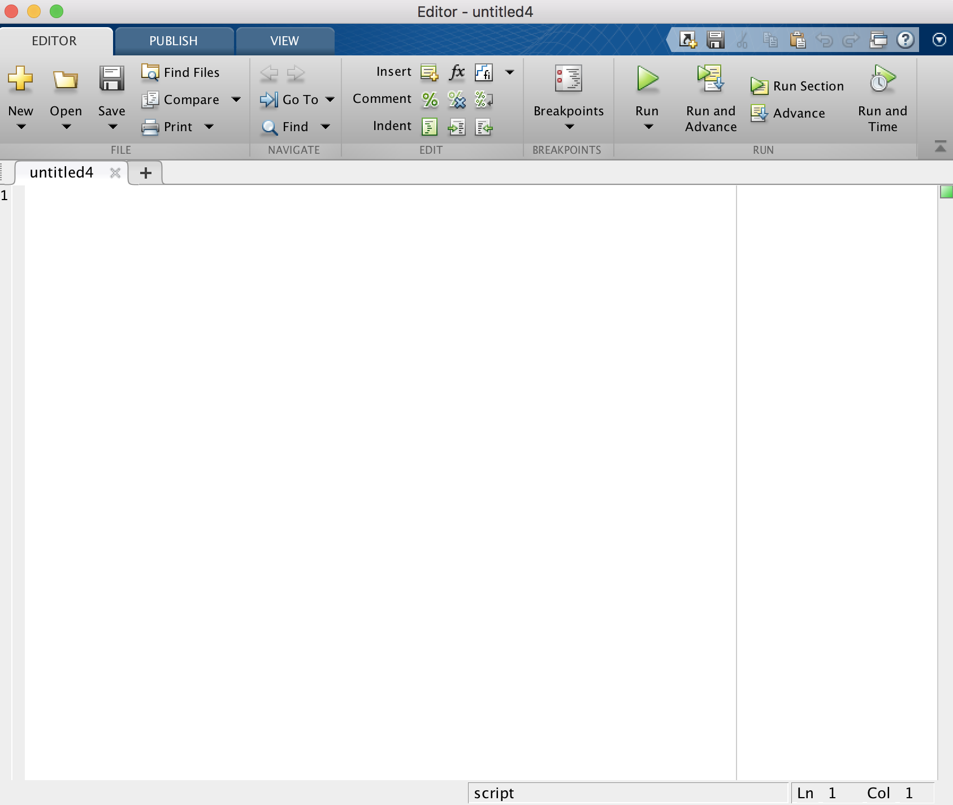
MATLAB scripts
A MATLAB script contains sequences of commands in text files that execute an algorithm
Files have the extension .m
Code for scripts are written in the editor window and executed at the MATLAB command line
Scripts are good to automate processes
Scripts can ‘call’ other scripts

Slide 21
Script writing
Good scripts are organized into sections:
Header
Contains documentation to be used with the Help function
Includes author statements (who wrote the code? What does it do? etc.)
Common variables/functions/packages
Clear workspace, load data, define global variables, etc.
Break up different blocks of code for each segment of analysis
Readability is important:
Suppress all intermediate statements
Use white space (between sections, etc.) and intuitive variable names
Every section should be commented to describe what is being done
Wrapping text to keep column width consistent
Download and open up CalculateCircleArea.m

Slide 22
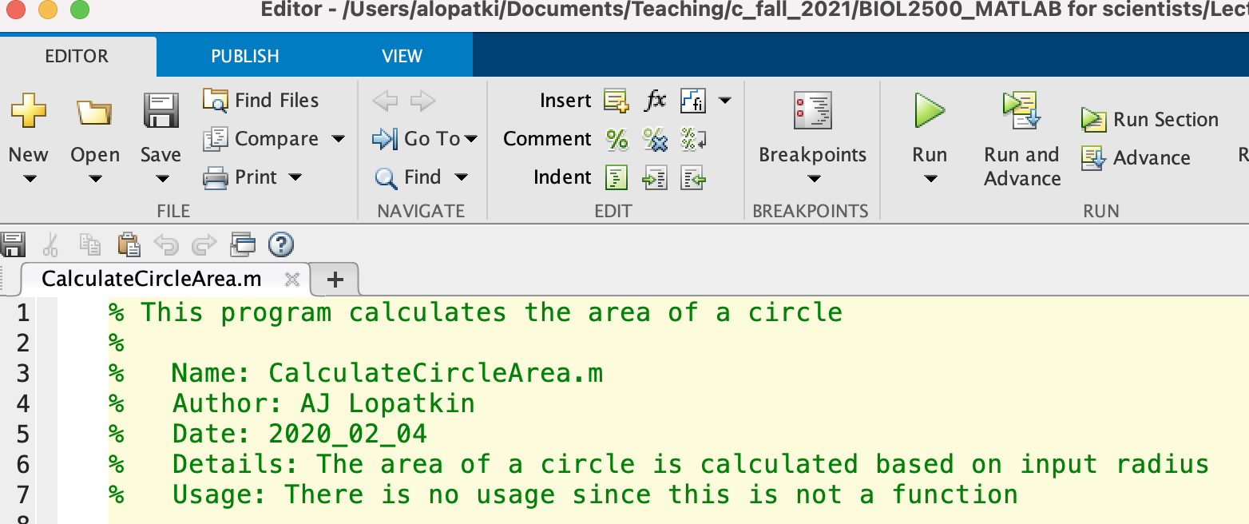
How to run a script
Click the ”Play” button at the top
Enter the name on the command line
Call from another script

Slide 23
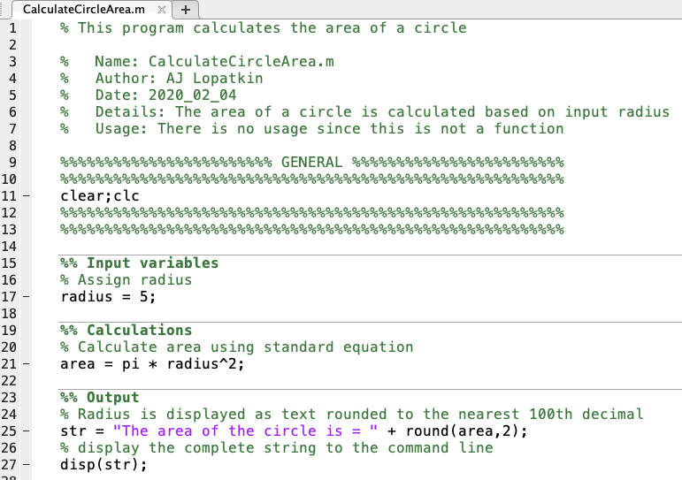
A note on hard coding
Hard-coded values are fixed numbers. Minimize these as much as possible

Slide 24
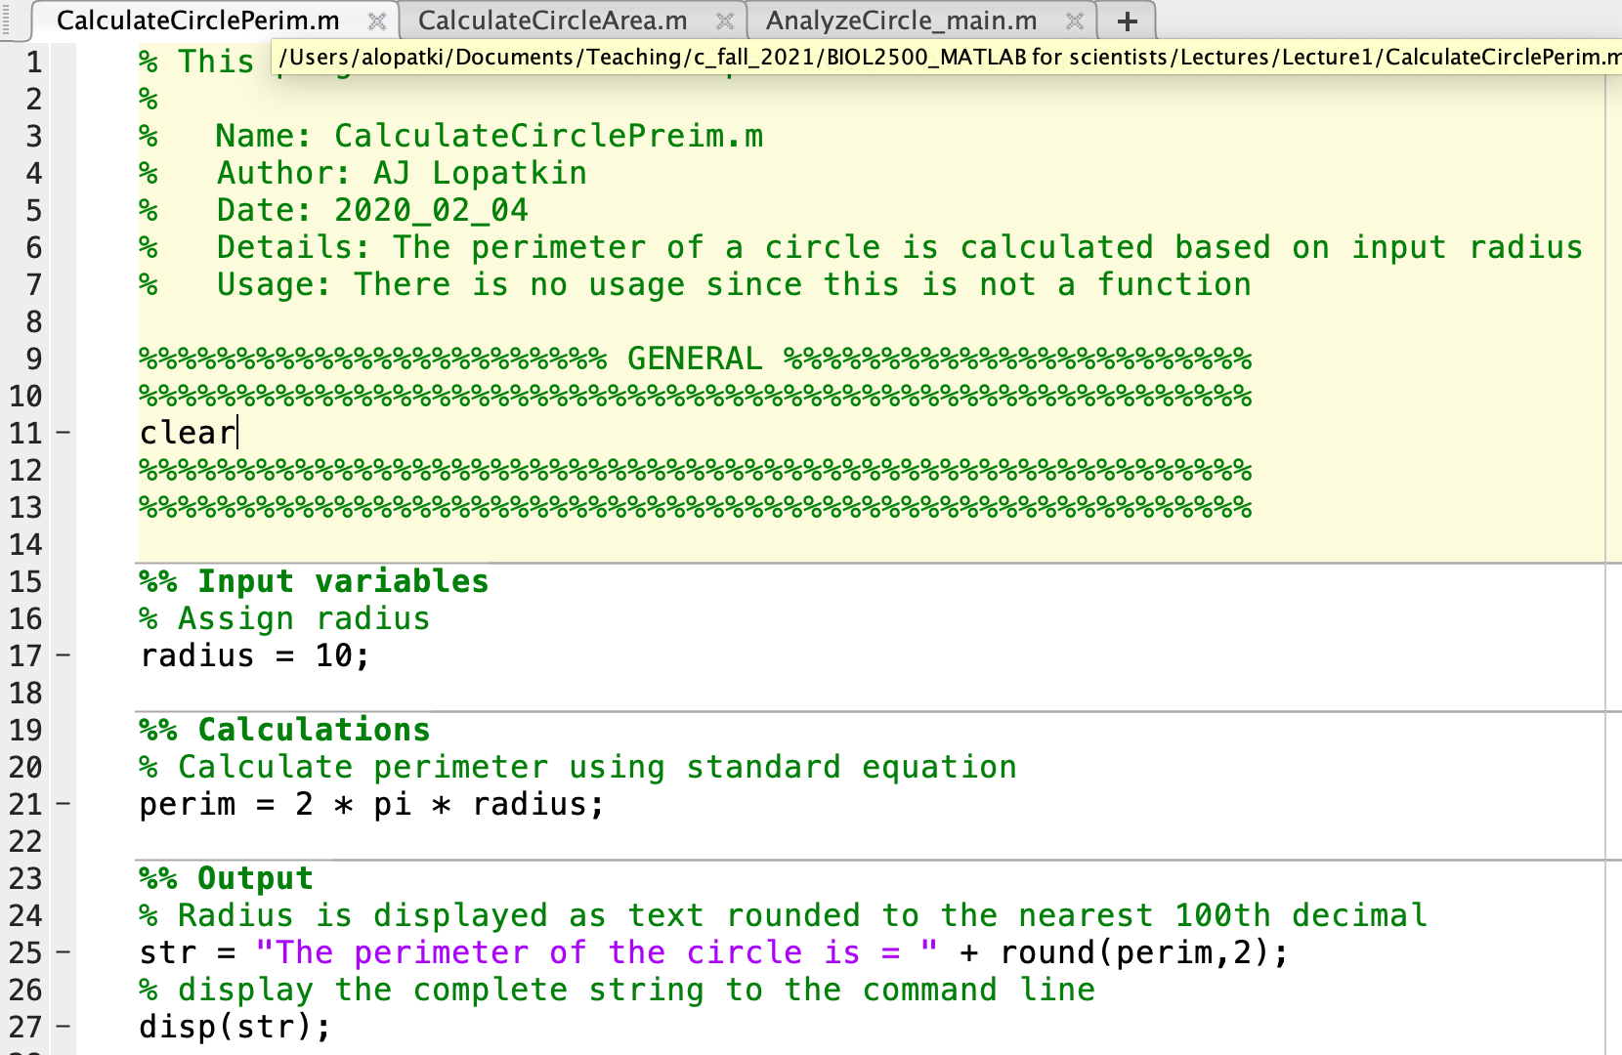
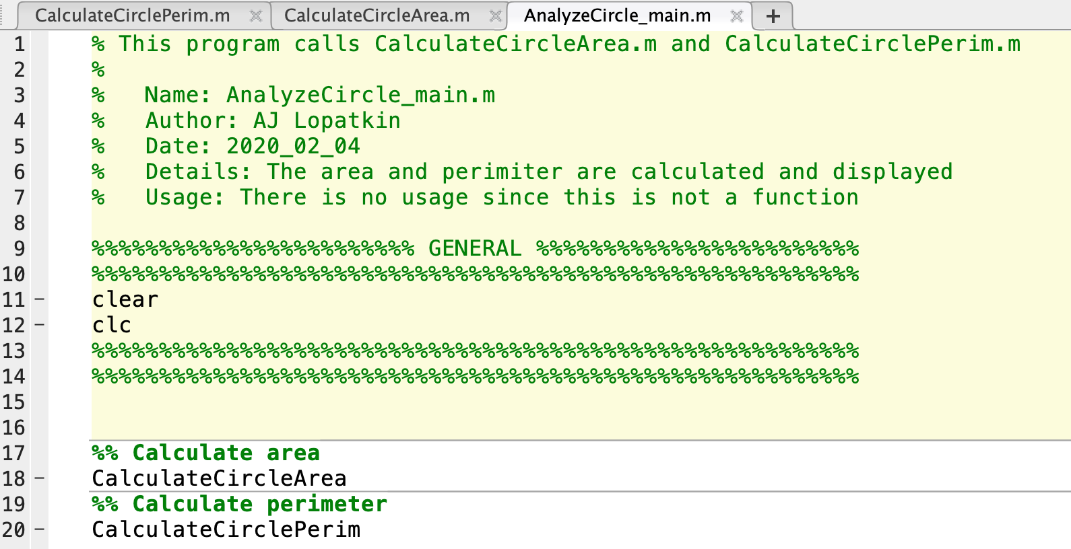
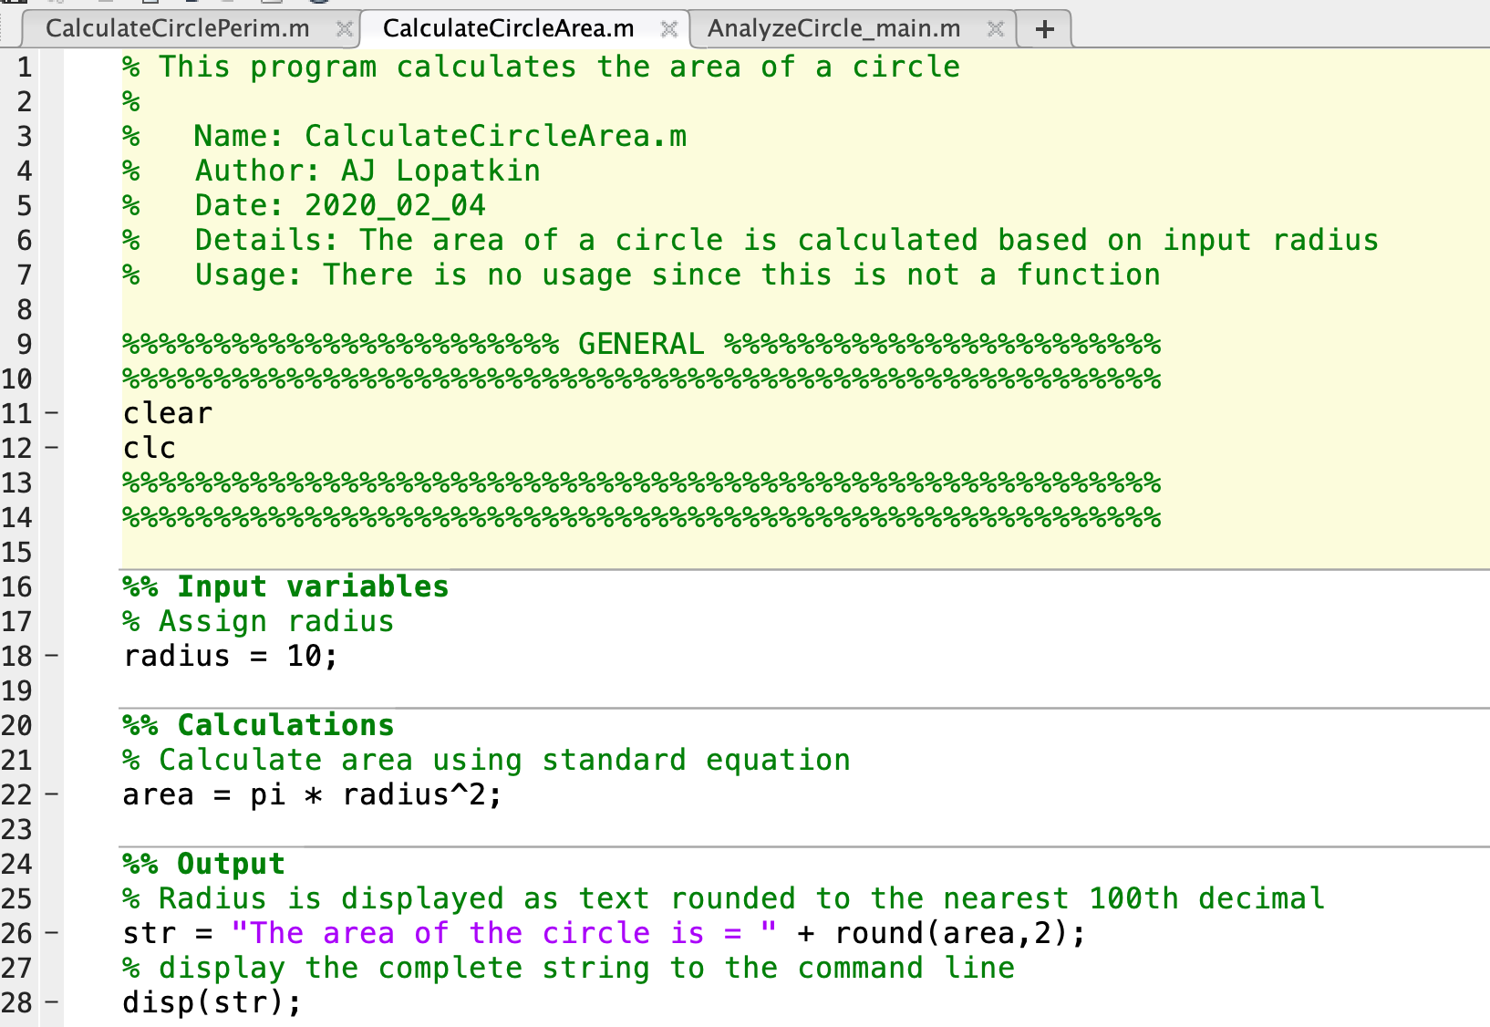
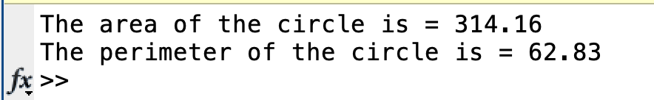
Calling scripts from other scripts

Slide 25
Download lecture1_grpEx1_template.m and complete the following:
A box is 12 inches high, 8 inches long and 2 inches wide. Currently 30% of the box’s surface area is covered. Write a script that (1) calculates the surface area (SA) of the box, (2) calculates the amount of SA that is covered (e.g., 30%), and (3) displays the amount of the SA that is uncovered in a complete sentence. Use the formula below:
SA = 2*l*w + 2*l*h + 2*h*w
Rules to follow (same for HW):
No hard-coded numbers beyond the minimum necessary
Suppress everything that is not the script output
(Unlike in HW, comments are included for you)
Group exercise 1

Slide 26
Wrap up
Homework1 is due next Monday at 11:59PM
Make sure to label it according to the convention: HW1_<Student ID>_script.m (eg: CO421234)
Our TA grades all HWs – it MUST be anonymous
TA office hours are: Thursdays 12:30-1:30 in Altschul 1207
EMAIL ME BY FRIDAY to confirm/hold your spot in the class

